Slide 1
Market structure
Sunitha A S
SoMS

Slide 2
Market and Market structure
Market : Any arrangement that enables buyers and sellers to contact for transactions.
Features/components of the market
Sellers
Buyers
Nature of products
Conditions of entry and exit
Negotiation of price
Transfer of ownership
Transfer of money or equal value

Slide 3
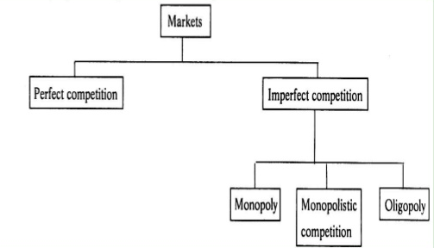
Competitive Based Market structure
The less the power an individual firm has to influence the market in which it operates, the more competitive that the market is.
Type of competition
Perfect competition
Imperfect competition

Slide 4
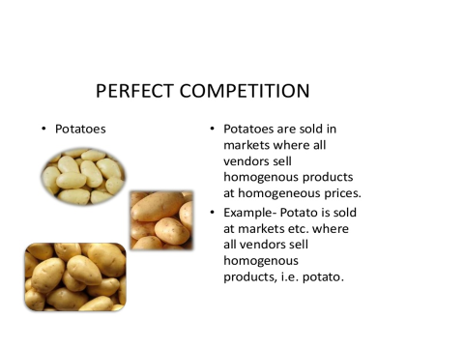
Pure/Perfect competition
Kenneth Boulding, says “Pure competition is that situation of market where many buyers and sellers are there for a commodity. Sellers sale uniform products at the same price. A firm is not in the position of determine the price , it is to be determined by the industry.

Slide 5
Features of perfect competition
Large number of firms or sellers
Large number of buyers
Homogeneous product (P=AR=MR)
Perfect knowledge
Free entry and exit of firms
Perfect mobility of factors of production as well as products.
Goal of the firm to maximize profit
No government regulation

Slide 6
Equilibrium of the firm
Firm is in equilibrium when it maximise profits (π)
π = TR-TC (TR-Total Revenue, TC-Total Cost)
π Is the profit above the normal rate of return on capital and remuneration for the risk bearing function of entrepreneur
The firm is in equilibrium when it produces the output that maximises the difference between total receipts and total costs. This equilibrium of the firm may be shown in two ways
1) TR and TC Curves
2) MR and MC curves

Slide 7
Equilibrium of the firm.
To attain an equilibrium position, a firm must satisfy the following two conditions:
They must ensure that the marginal revenue is equal to the marginal cost (MR = MC).
If MR > MC, the firm has an incentive to expand its production and sell additional units.
If MR < MC, the firm must reduce the output since additional units add more cost than revenue.
The firm gets maximum profits only when MR = MC.
The MC curve must have a positive slope and cut the MR curve from below.

Slide 8
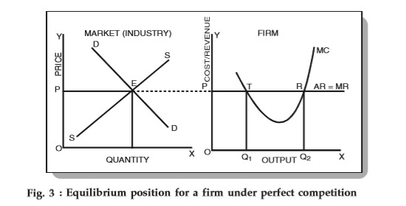
Equilibrium of the firm.

Slide 9
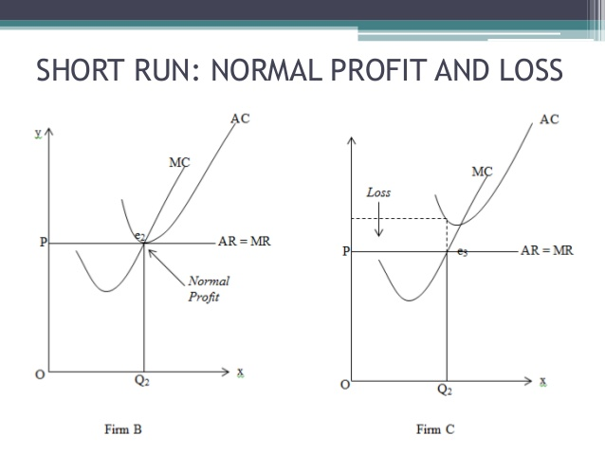

Slide 10
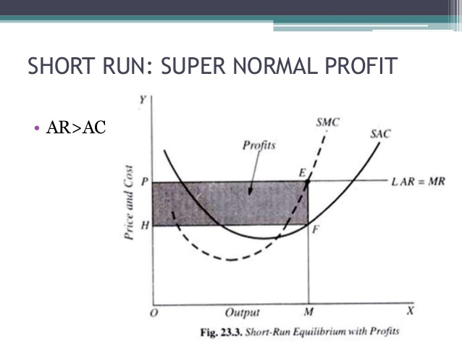

Slide 11
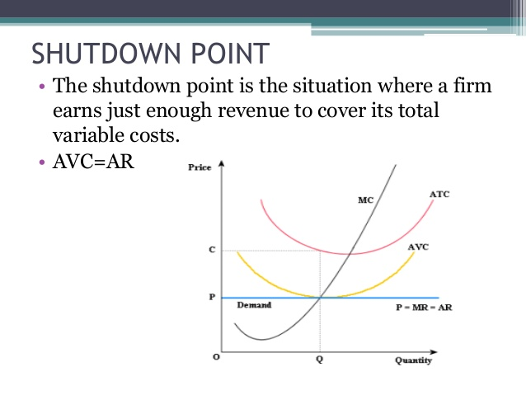

Slide 12
Price output determination-Long Run

Slide 13
Numerical Problem
Suppose there is a perfectly competitive industry where all the firms are identical with identical cost curves. Furthermore, suppose that a representative firm’s total cost is given by the equation TC = 100 + q2 + q where q is the quantity of output produced by the firm. You also know that the market demand for this product is given by the equation P = 1000 – 2Q where Q is the market quantity. In addition you are told that the market supply curve is given by the equation P = 100 + Q.
What is the equilibrium quantity and price in this market given this information?
The firm’s MC equation based upon its TC equation is MC = 2q + 1. Given this information and your answer in part (a), what is the firm’s profit maximizing level of production, total revenue, total cost and profit at this market equilibrium? Is this a short-run or long-run equilibrium? Explain your answer.
Given your answer in part (b), what do you anticipate will happen in this market in the long-run?

Slide 14
Thank you

